Slide 1

SIMULATING CAT QUBITS
<Qis|kers>: Anjali Amin, Jojo Day, Grace Pang,
Jerison Parra, Brandon Perez
iQuHack 2025 - Alice & Bob

Slide 2
OVERVIEW
01
SIMULATING A CAT QUBIT
03
PERFORMING A Z-GATE
Coupling Memory and Lossy Buffer
Understanding our Hamiltonian
Plotting our Wigner Function
Analysis
Understanding our Hamiltonian
Simulate a Pi Rotation
Optimizing our Parameters
02
COMPARISON W. NO BUFFER
04
CLOSING
Eliminating Buffer Mode
Computing Fidelity vs. Time
What happens as kappa_b decreases?
Implications of Cat Qubits
Future Works
Thank You!

Slide 3
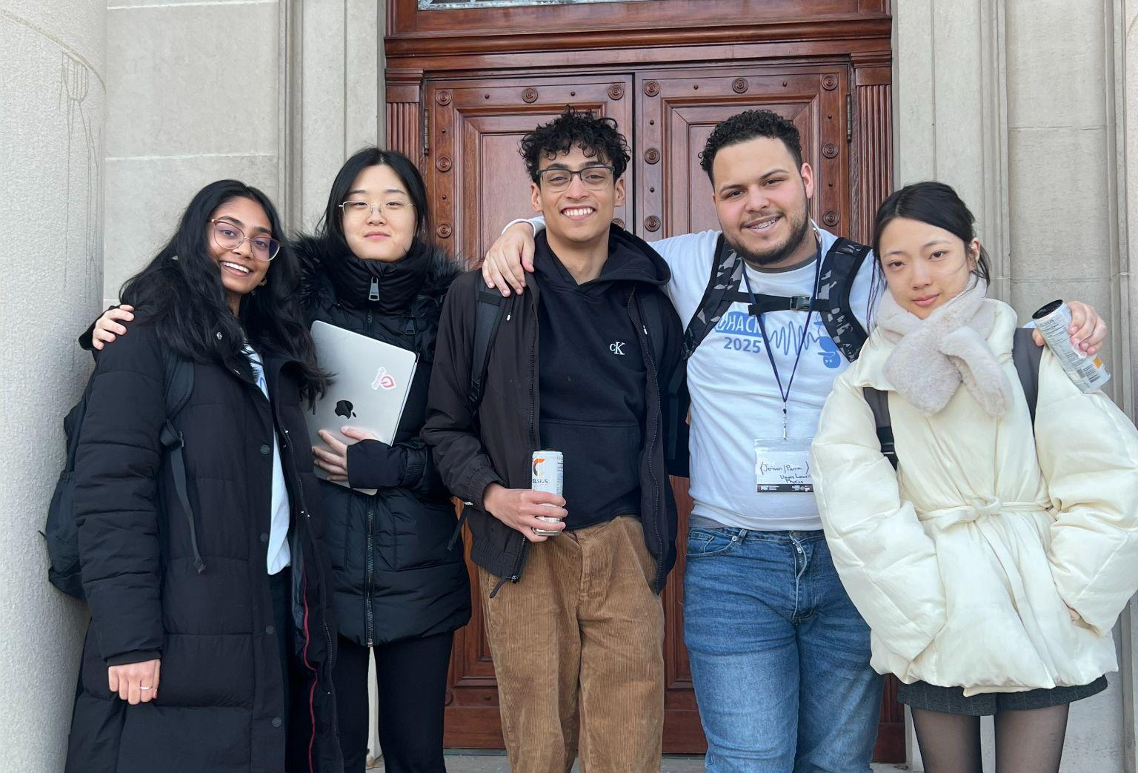

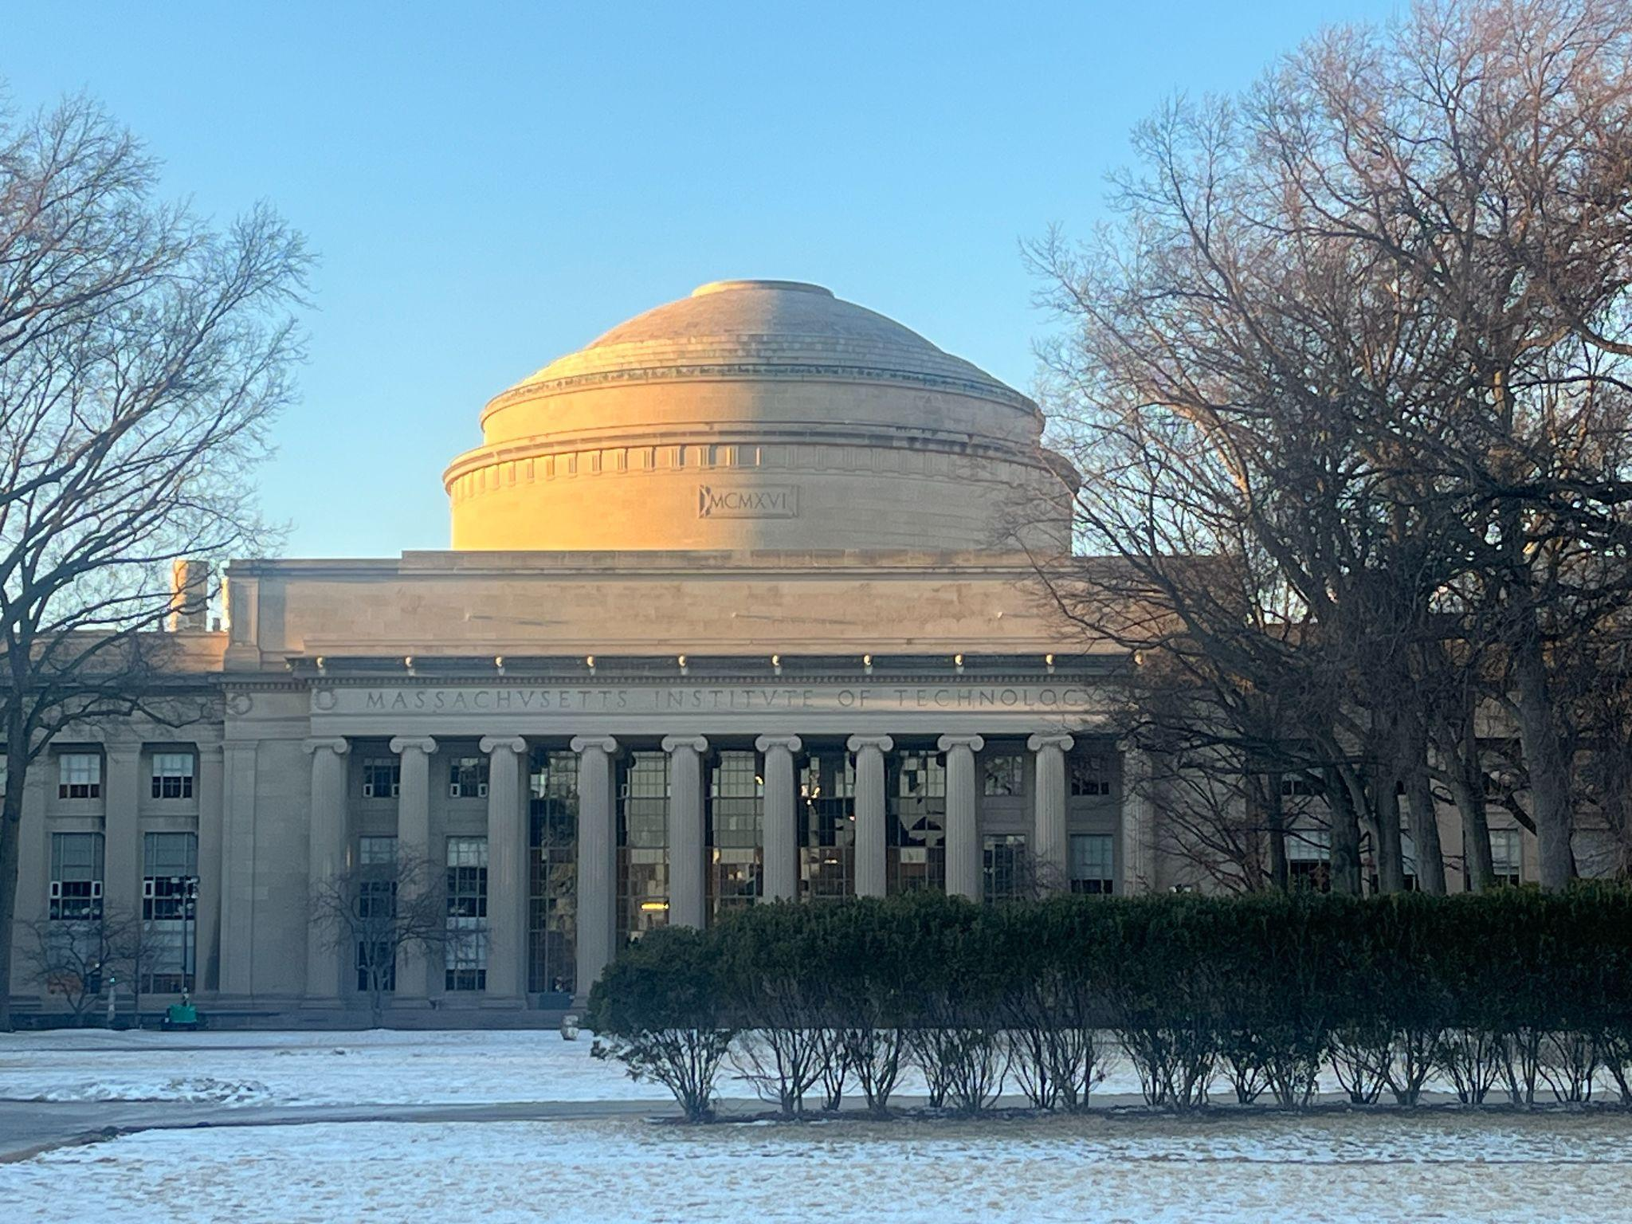
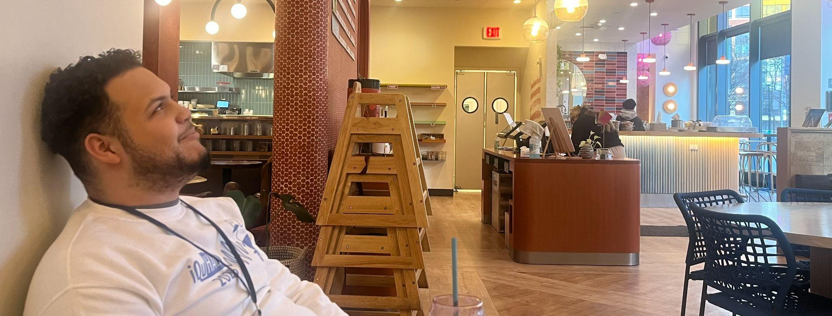
WHO ARE WE?
UNIVERSITY OF COLORADO
UC DAVIS
Love Good Art
COMPUTER SCIENCE
BRANDEIS UNIVERSITY
BRANDEIS UNIVERSITY
BRANDEIS UNIVERSITY
Average Sleep: 1 Hour
UNIVERSITY OF MASSACHUSETTS LOWELL
UNIVERSITY OF MASSACHUSETTS LOWELL
Average Sleep: 1.5 Hours
PHYSICS
UC DAVIS
UC DAVIS

Slide 4
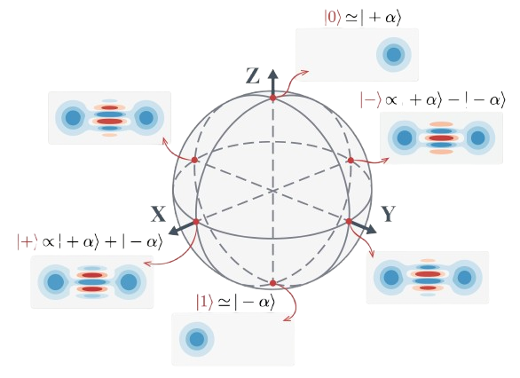
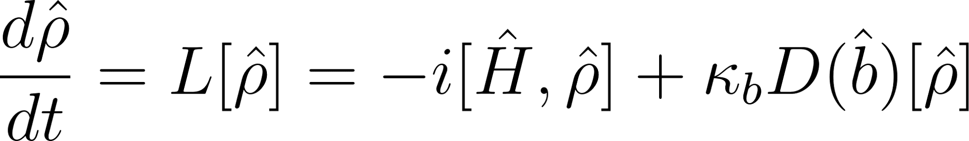
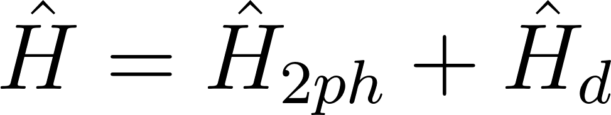
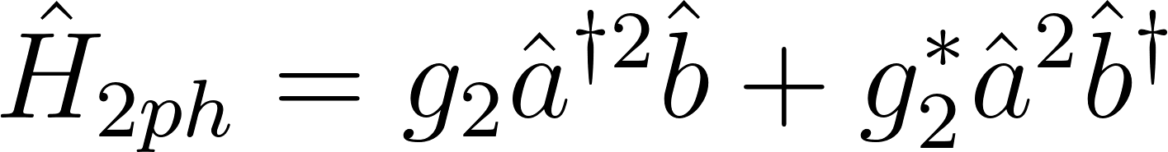
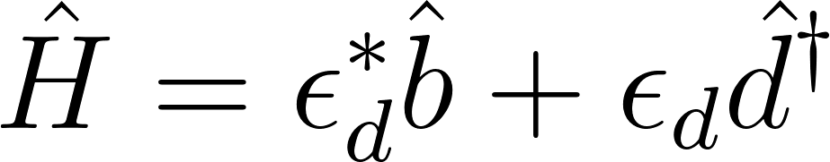
Cat Qubits -
Coupling Memory Modes with Lossy Buffer Modes
Lindblad Master Equation:
Hamiltonian of the System:

Slide 5
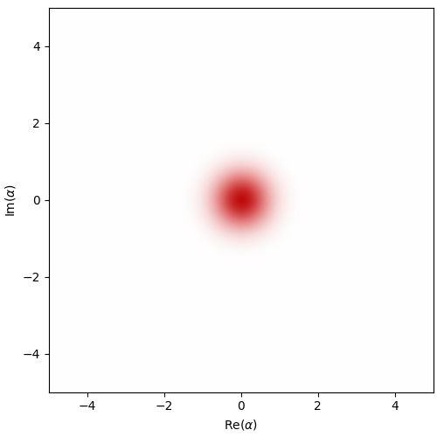
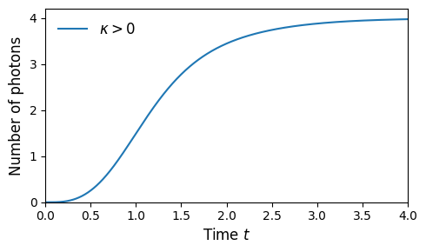
PLOTTING OUR WIGNER FUNCTION
Tools from Dynamiqs Library
Represent a Superposition State
Photons reach an Equilibrium
Give a Visually Intuitive Plot of
Qubits getting Encoded

Slide 6
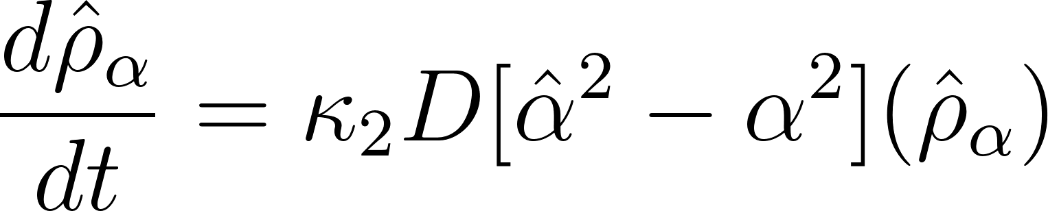
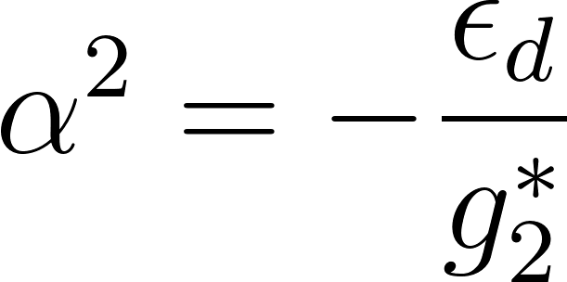
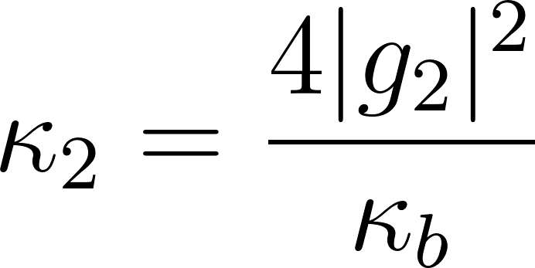
Comparing
our Initial Case
to a case with an Eliminated Buffer Mode
01
02
Initial Case
Adiabatically Eliminated Buffer Mode

Slide 7
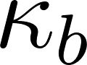
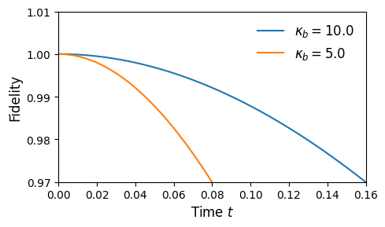
Analyzing Fidelity as Decreases
As Kappa Decreases, Fidelity decreases between our initial case and eliminated buffer case
Utilizing high values of Kappa provide more accurate estimations

Slide 8
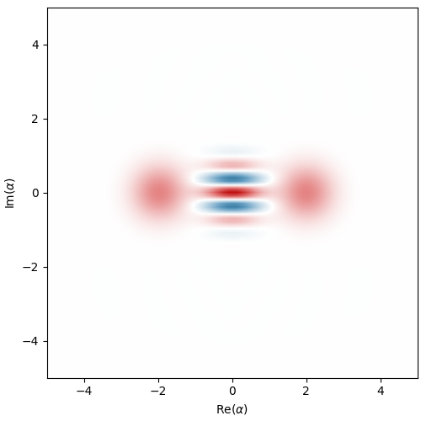
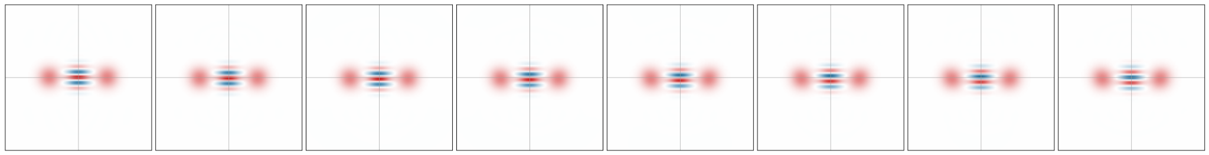
Performing a Zeno-Gate
Since we can now store information to our qubits,
it’s imperative to be able to perform operations on them
as well.
This gate performs a pi rotation on a superposition state,
providing a uniquely quantum transformation that can
be visualized as a mosaic and rotating gif!

Slide 9


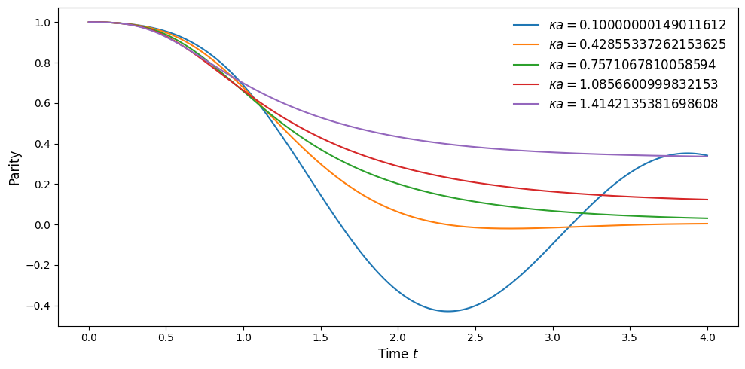
Visualizing Kappa vs. Time
 | Time
0.10000000149011612 | 3.062974214553833
0.14120227098464966 | 3.037816286087036
0.1824045330286026 | 3.000079393386841
0.22360679507255554 | 2.9560530185699463
2.2360680103302 | 0.27673688530921936

Slide 10
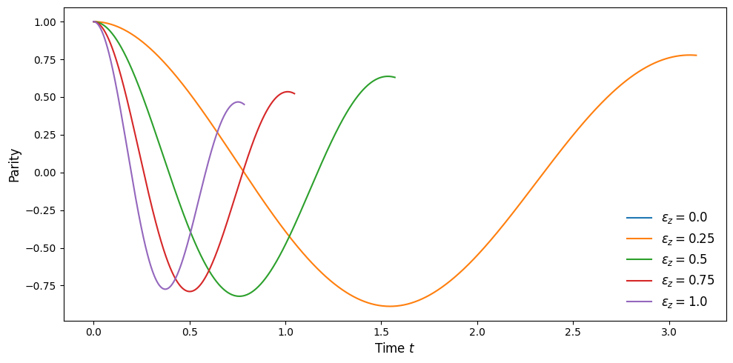

Visualizing Epsilon vs. Time
Epsilon | Time
0.0 | NA
0.25 | 3.08813214302063
0.50 | 1.5220528841018677
1.0 | 0.7484474778175354

Slide 11
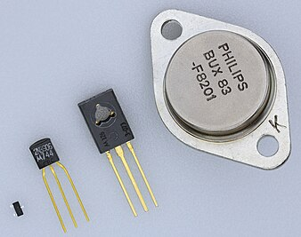

Crucial characteristics to be core building blocks for quantum systems
Scaling into larger logical qubits?
Utilizing estimations to model non-probabilistic (quantum) problems?
Projections for Quantum

Slide 12
Designing algorithms and full circuits with these tools
Performing similar analysis on other qubits
Deriving more precise estimations to potentially reduce costs in quantum
Future Works

Slide 13
THANK YOU!

